Slide 1
Learning Objective
I will be able to define sequences and arithmetic sequence given a rule.
Success Criteria
At the end of the lesson, I will be able to:
define a sequence and sequence notation using subscripts;
define recursion as a process;
perform basic operations with sequences; and
define an arithmetic sequence recursively and in terms of a common difference;
list terms of an arithmetic sequence given a rule;
write the recursive rule for an arithmetic sequence given terms;
derive the general (explicit) rule for an arithmetic sequence and make the connection to linear relationships;
find the nth term of an arithmetic sequence;
given two terms of an arithmetic sequence, find the common difference, first term and hence rules; and
verify whether a given value is part of an arithmetic sequence.

Slide 2
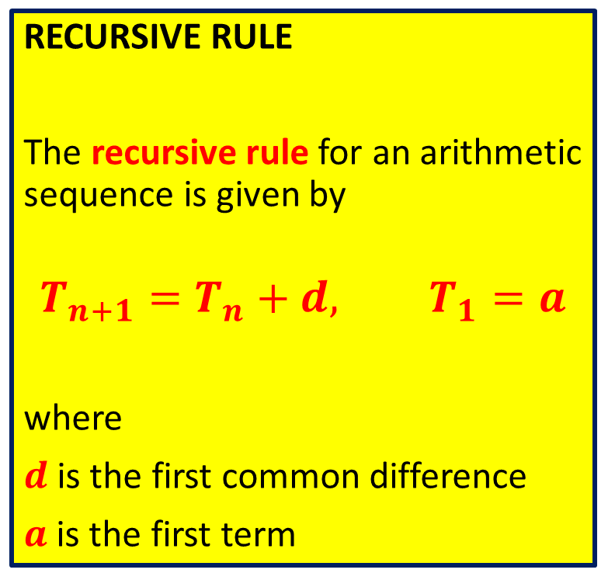
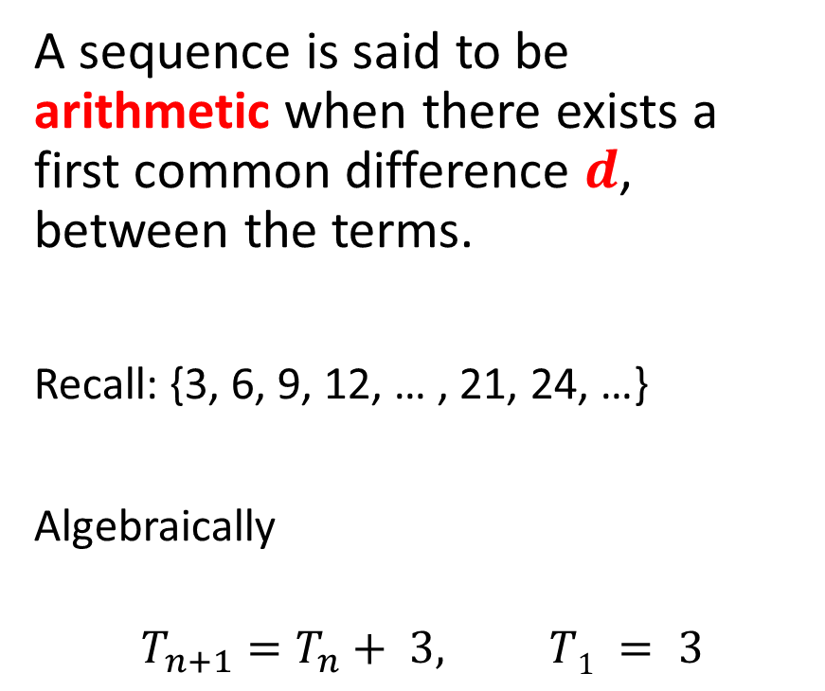
Arithmetic Sequence
Concept Development
RECURSIVE RULE
The recursive rule for an arithmetic sequence is given by
$$T_{n+1}=T_{n}+d, T_{1}=a$$
where
$d$ is the first common difference
$a$ is the first term
A sequence is said to be arithmetic when there exists a first common difference 𝒅, between the terms.
Recall: {3, 6, 9, 12, … , 21, 24, …}
Algebraically
$$T_{n+1}=T_{n}+ 3, T1 = 3$$

Slide 3



Consider: $T_{n+1}=T_{n}−2, T1 =19$
Skill Development
Describe this rule:
What is $T_{2}$?
Start with the number 19, and subtract by 2. The process continues.
19 is the first term. -2 is the common difference.
$$T_{2}=T_{1}−2=19−2=17$$

Slide 4






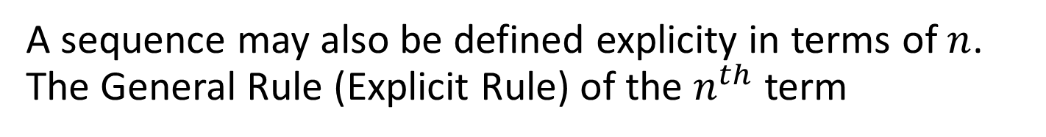






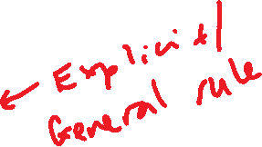



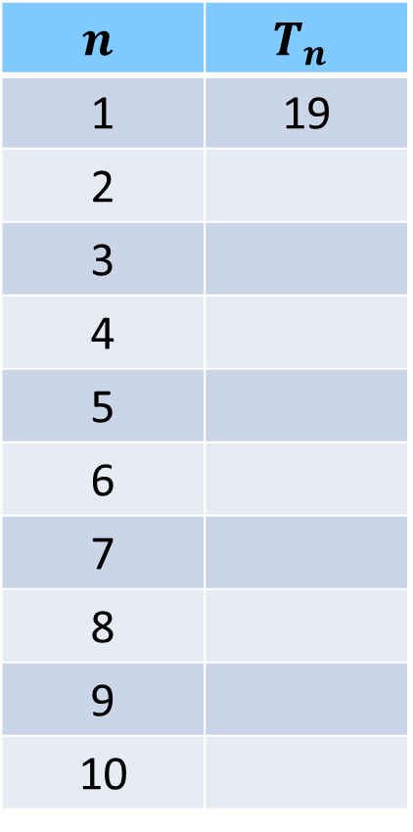


A sequence may also be defined explicity in terms of $n$. The General Rule (Explicit Rule) of the $n^{th}$ term
Skill Development
Consider $T_{n+1}=T_{n}−2, T1 =19$
$$n$$ | $$T_{n}$$
1 | 19
2
3
4
5
6
7
8
9
10
$$2$$
When we jumped to the 3rd term, two is subtracted ____ times.
When we jumped to the 5th term, two is subtracted ____ times.
When we jumped to the 10th term, two is subtracted ____ times.
When we jumped to the n^{th} term, two is subtracted ____ times.
So, the general rule is:
$$4$$
$$17$$
$$9$$
$$15$$
$$n−1$$
$$13$$
$$11$$
$$9$$
$$T_{n}=T_{1}−2\left(n−1\right)$$
$$7$$
$$5$$
$$T_{n}=19−2n+2$$
$$3$$
$$T_{n}=21−2n$$
$$1$$

Slide 5
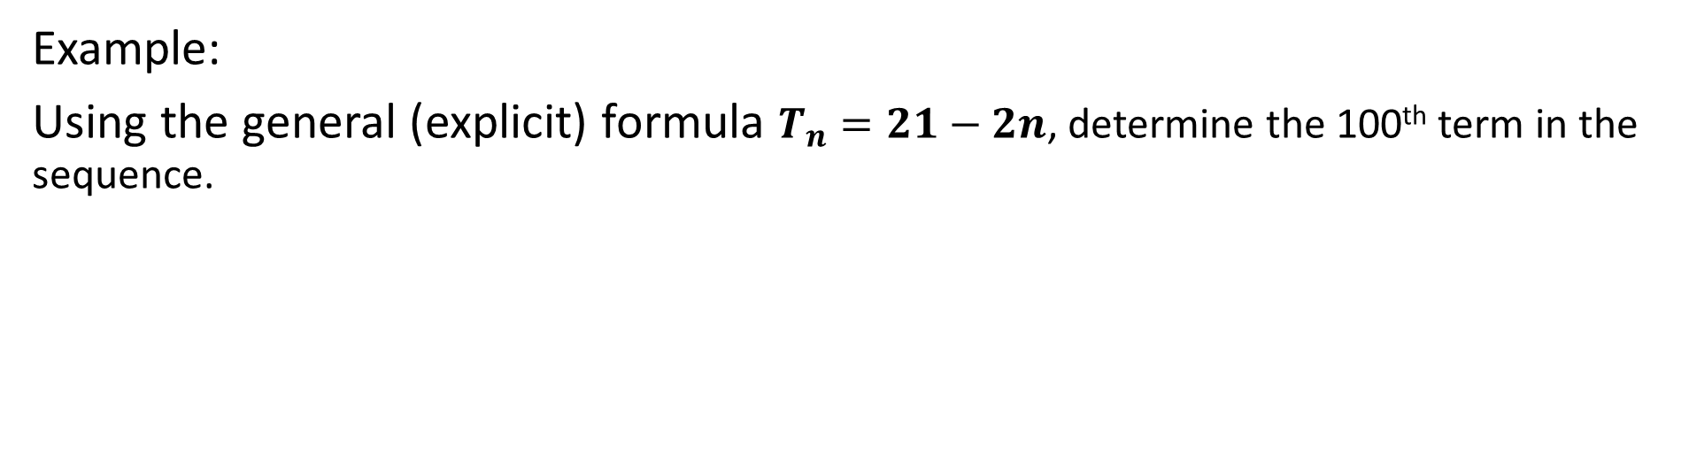
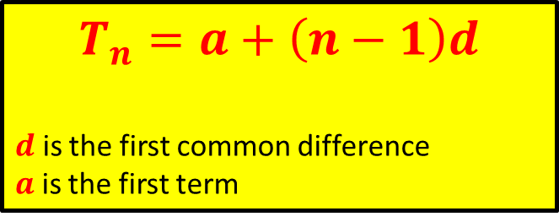
The General Rule (Explicit Rule) of the $n^{th}$ term for an arithmetic sequence
Skill Development
$$T_{n}=a+\left(n−1\right)d$$
$d$ is the first common difference
$a$ is the first term
Example:
Using the general (explicit) formula $T_{n}=21−2n$, determine the 100th term in the sequence.
$$T_{100}=21−2\left(100\right)=−179$$

Slide 6
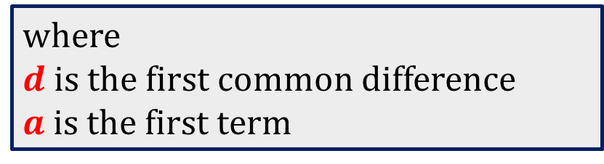
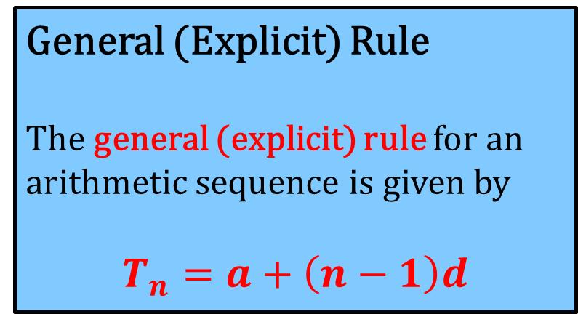
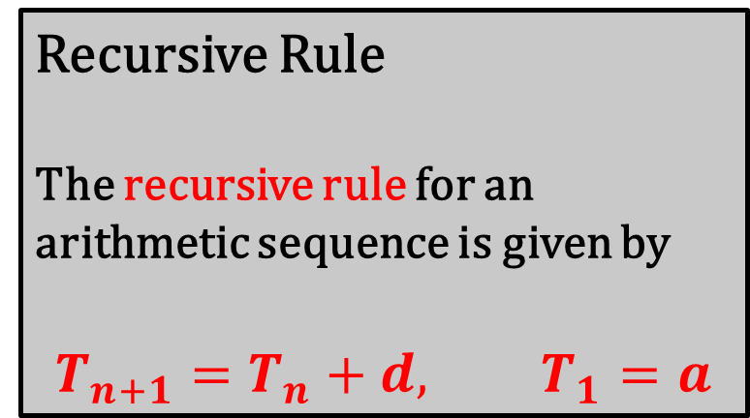
Concept Development
Recursive Rule
The recursive rule for an arithmetic sequence is given by
$$T_{n+1}=T_{n}+d, T_{1}=a$$
General (Explicit) Rule
The general (explicit) rule for an arithmetic sequence is given by
$$T_{n}=a+\left(n−1\right)d$$
where
$d$ is the first common difference
$a$ is the first term

Slide 7

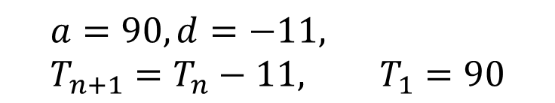
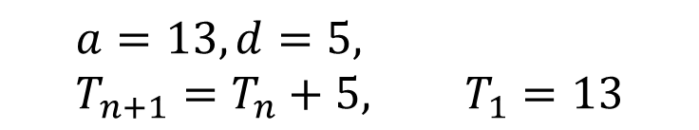



For each of the following sequences, state if the sequence follows an Arithmetic Progression (AP) or not. For those that are, state the first term, common difference and a recursive formula. a) 13, 18, 23, 28, 33, 38, … b) 3, 6, 12, 24, 48, 96, … c) 90, 79, 68, 57, 46, 35, …
Guided Practice
As each term is 5 more than the previous, it is an AP
a) 13, 18, 23, 28, 33, 38, …
$$a=13, d=5, \\ T_{n+1}=T_{n}+5, T_{1}=13$$
b) 3, 6, 12, 24, 48, 96, …
As each term does not have a common difference, it is not an AP
c) 90, 79, 68, 57, 46, 35, …
As each term is 11 less than the previous, it is an AP
$$a=90, d=−11, \\ T_{n+1}=T_{n}−11, T_{1}=90$$

Slide 8


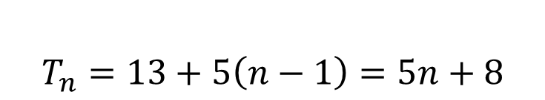
Guided Practice
For the AP sequence below, determine the general (explicit) rule.
a) 13, 18, 23, 28, 33, 38, …
$$a=13, d=5,$$
$$T_{n}=13+5\left(n−1\right)=5n+8$$
b) 90, 79, 68, 57, 46, 35, …
$$a=90, d=−11,$$
$$T_{n}=90−11\left(n−1\right)=101−11n$$

Slide 9


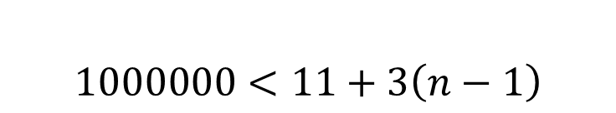
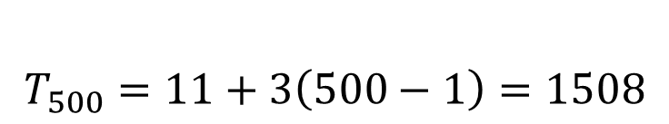
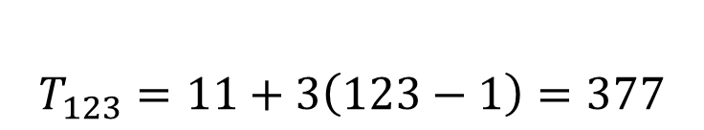

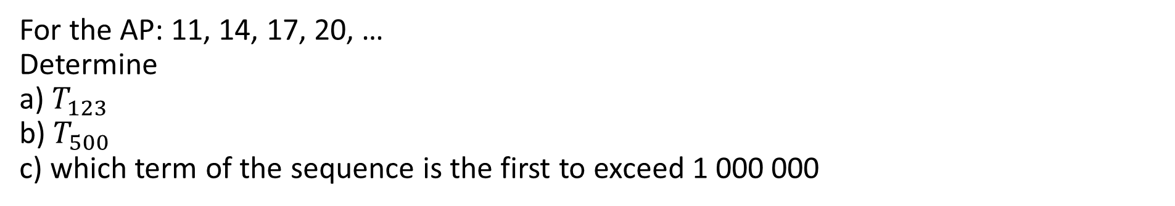
For the AP: 11, 14, 17, 20, … Determine a) $T_{123}$ b) $T_{500}$ c) which term of the sequence is the first to exceed 1 000 000
Guided Practice
$$a=11, d=3,$$
$$T_{n}=11+3(n−1)$$
$$T_{123}=11+3\left(123−1\right)=377$$
$$T_{500}=11+3\left(500−1\right)=1508$$
$$1000000<11+3\left(n−1\right)$$

Slide 10



Find the 10th term of the arithmetic sequence -4, -1, 2, 5, …
Guided Practice
$$a=−4, d=3$$
$$T_{n}=−4+3(n−1)$$
$$T_{10}=−4+3\left(10−1\right)=23$$

Slide 11




If 41 is the nth term in the arithmetic sequence, -4, -1, 2, 5, … find the value of n
Guided Practice
$$a=−4, d=3$$
$$T_{n}=−4+3(n−1)$$
$$41=−4+3\left(n−1\right)$$
$$45=3\left(n−1\right)$$
$$15=\left(n−1\right)$$
$$n=16$$

Slide 12



The 12th term of an arithmetic sequence is 9 and the 25th term is 100. Find $a$ and $d$ and hence find the 8th term.
Guided Practice
$$T_{12}=9=a+d\left(12−1\right)−−−\left(1\right)$$
$$T_{25}=100=a+d\left(25−1\right)−−−(2)$$
$$\left(2\right)−\left(1\right), 91=13d$$
$$d=7$$
$$9=a+7(11)$$
$$a=−68$$
$$T_{n}=−68+7\left(n−1\right)=7n−75$$
$$T_{8}=−68+7(7)$$
$$T_{8}=−19$$

Slide 13



For the arithmetic sequence that has $T_{3}=18, T_{6}=486,$ find the rule for the sequence.
Guided Practice
$$T_{3}=18=a+d\left(3−1\right)−−−\left(1\right)$$
$$T_{6}=486=a+d\left(6−1\right)−−−(2)$$
$$\left(2\right)−\left(1\right), 468=3d$$
$$d=156$$
$$18=a+156(2)$$
$$a=−294$$
$$T_{n}=−294+156(n−1)$$
$$T_{n}=156n−450$$

Slide 14


The arithmetic mean of 2 numbers $a, b$ is defined as
Skill Development
$$\frac{a+b}{2}$$
Example:
Find the arithmetic mean of 8 and 15
$$\frac{8+15}{2}=\frac{23}{2}=11.5$$

Slide 15
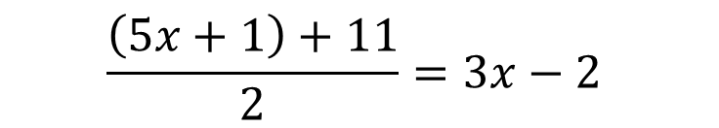



Find $x$ if $3x−2$ is the arithmetic mean of $5x+1$ and 11
Guided Practice
$$\frac{\left(5x+1\right)+11}{2}=3x−2$$
$$5x+12=6x−4$$
$$12+4=6x−5x$$
$$x=16$$

Slide 16




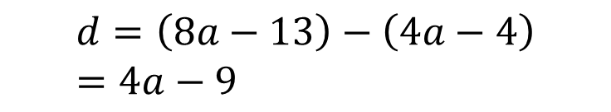
If $a, 4a−4$ and $8a−13$ are successive terms of an arithmetic sequence, find $a$
Guided Practice
$$d=\left(4a−4\right)−a$$
$$=3a−4$$
$$d=\left(8a−13\right)−\left(4a−4\right) \\ =4a−9$$
$$3a−4=4a−9$$
$$9−4=4a−3a$$
$$a=5$$

Slide 17











If $t_{m}=n, t_{n}=m$, prove that $t_{m+n}=0$.
Guided Practice
$$t_{m}=n=a+d\left(m−1\right) −(1)$$
$$n=a−1(m−1)$$
$$t_{n}=m=a+d\left(n−1\right) −(2)$$
$$n=a−m+1$$
$$a=n+m−1$$
$$\left(2\right)−\left(1\right), m−n=nd−md$$
$$t_{m+n}=n+m−1−1\left(m+n−1\right)$$
$$m−n=d(n−m)$$
$$=n+m−1−m−n+1$$
$$m−n=−d(m−n)$$
$$m−n+d\left(m−n\right)=0$$
$$=0$$
$$\left(m−n\right)\left(1+d\right)=0$$
$$m=n \left(not possible\right) or d=−1$$

Slide 18
Independent Practice
Complete Cambridge Ex 15B

